Slide 1

Knowledge Graph of Printers using Social Media Posts

Slide 2
Problem Statement
Understanding customer sentiments about products is of utmost priority for any product company including HP. Consumers are more vocal on social media platforms and expressing their feedback and experience about any product. HP too need to know consumer sentiments first-hand so that it can make better products with great user experience and resolve customer issue faster. We need a one stop knowledge store, which can store reviews, suggestions, complaint and sentiments for all HP consumer printers. This will help HP understand the consumers better and improve brand value and NPS score.

Slide 3

Introduction
Name - Rohan Misal
College - NBN Sinhgad School Of Engineering
Education Stream - Computer Engineearing
Email ID - rohanmisal89@gmail.com

Slide 4
Process
Step 1:
Data Collection
Gather relevant data from various sources.
Step 2:
Data Preprocessing
Step 3:
Entity Extraction
Clean and filter the collected data to remove noise.
Identify printer-related entities in the social media posts.
Step 4:
Attribute Identification
Step 5:
Relationship Identification
Determine the attributes associated with each printer entity.
Identify relationships between printer entities based on the context of social media posts.

Slide 5

Process
Step 6:
Knowledge Graph Construction
Step 7:
Linking and Enrichment
Design and build the knowledge graph structure using a suitable graph database or framework.
Step 8: Visualization and Exploration
Step 9: Continuous Learning and Updating
Link the printer entities in the knowledge graph to external data sources, such as product databases or specifications.
Step 10: Application and Analysis
Visualize the knowledge graph using interactive tools.
Regularly update the knowledge graph.
Utilize the knowledge graph to power applications.

Slide 6
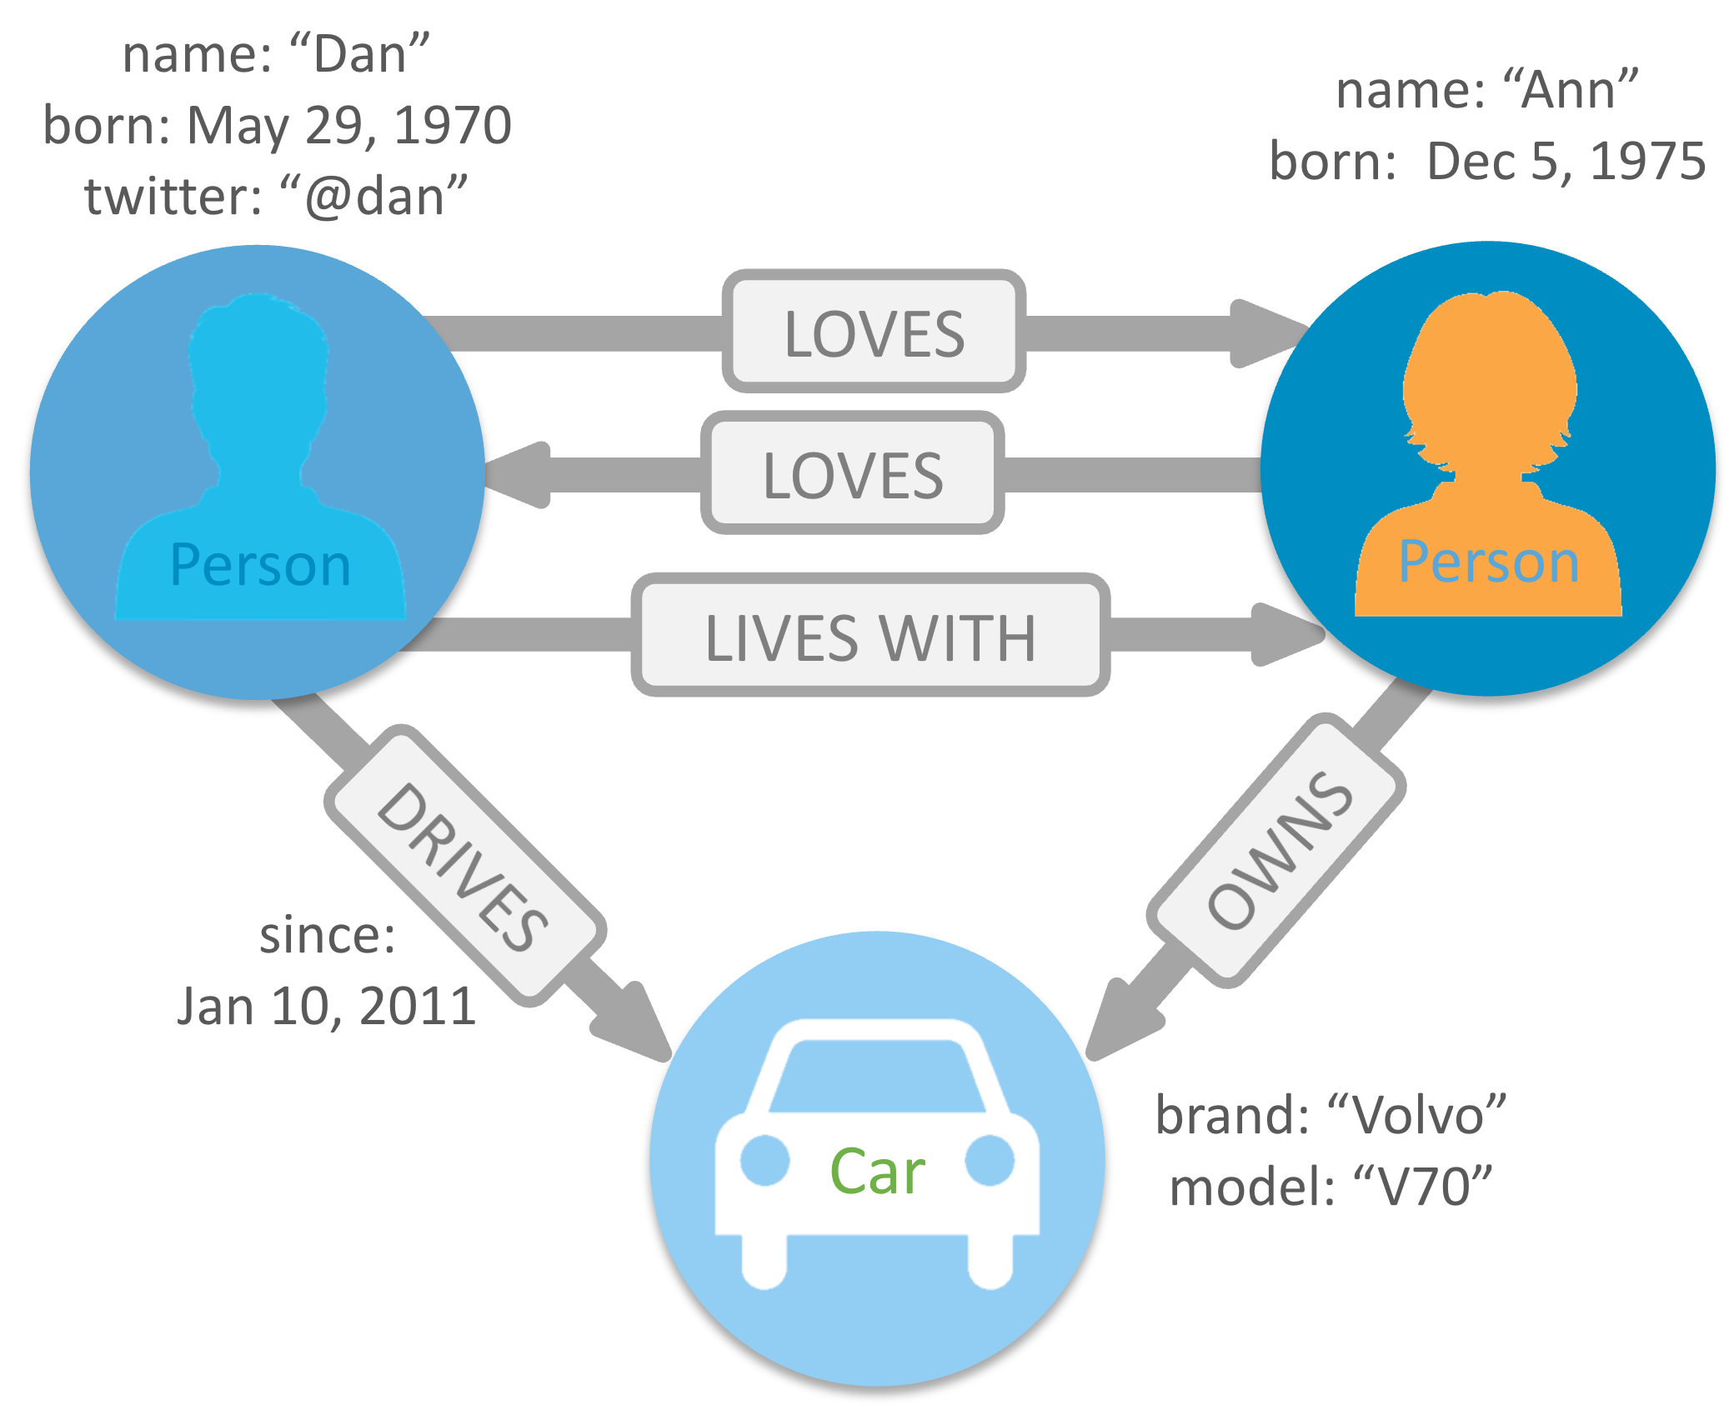
Understanding Knowledge Graphs

Slide 7
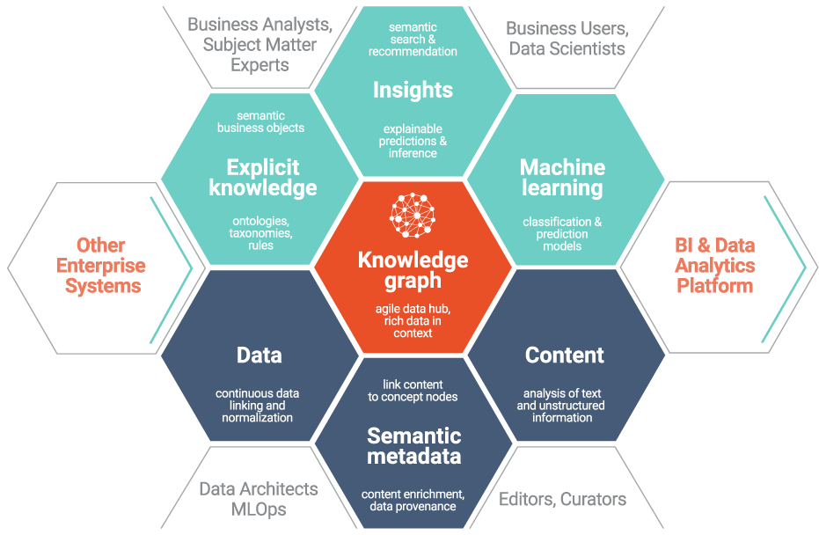
Importance of Knowledge Graphs for Printers

Slide 8

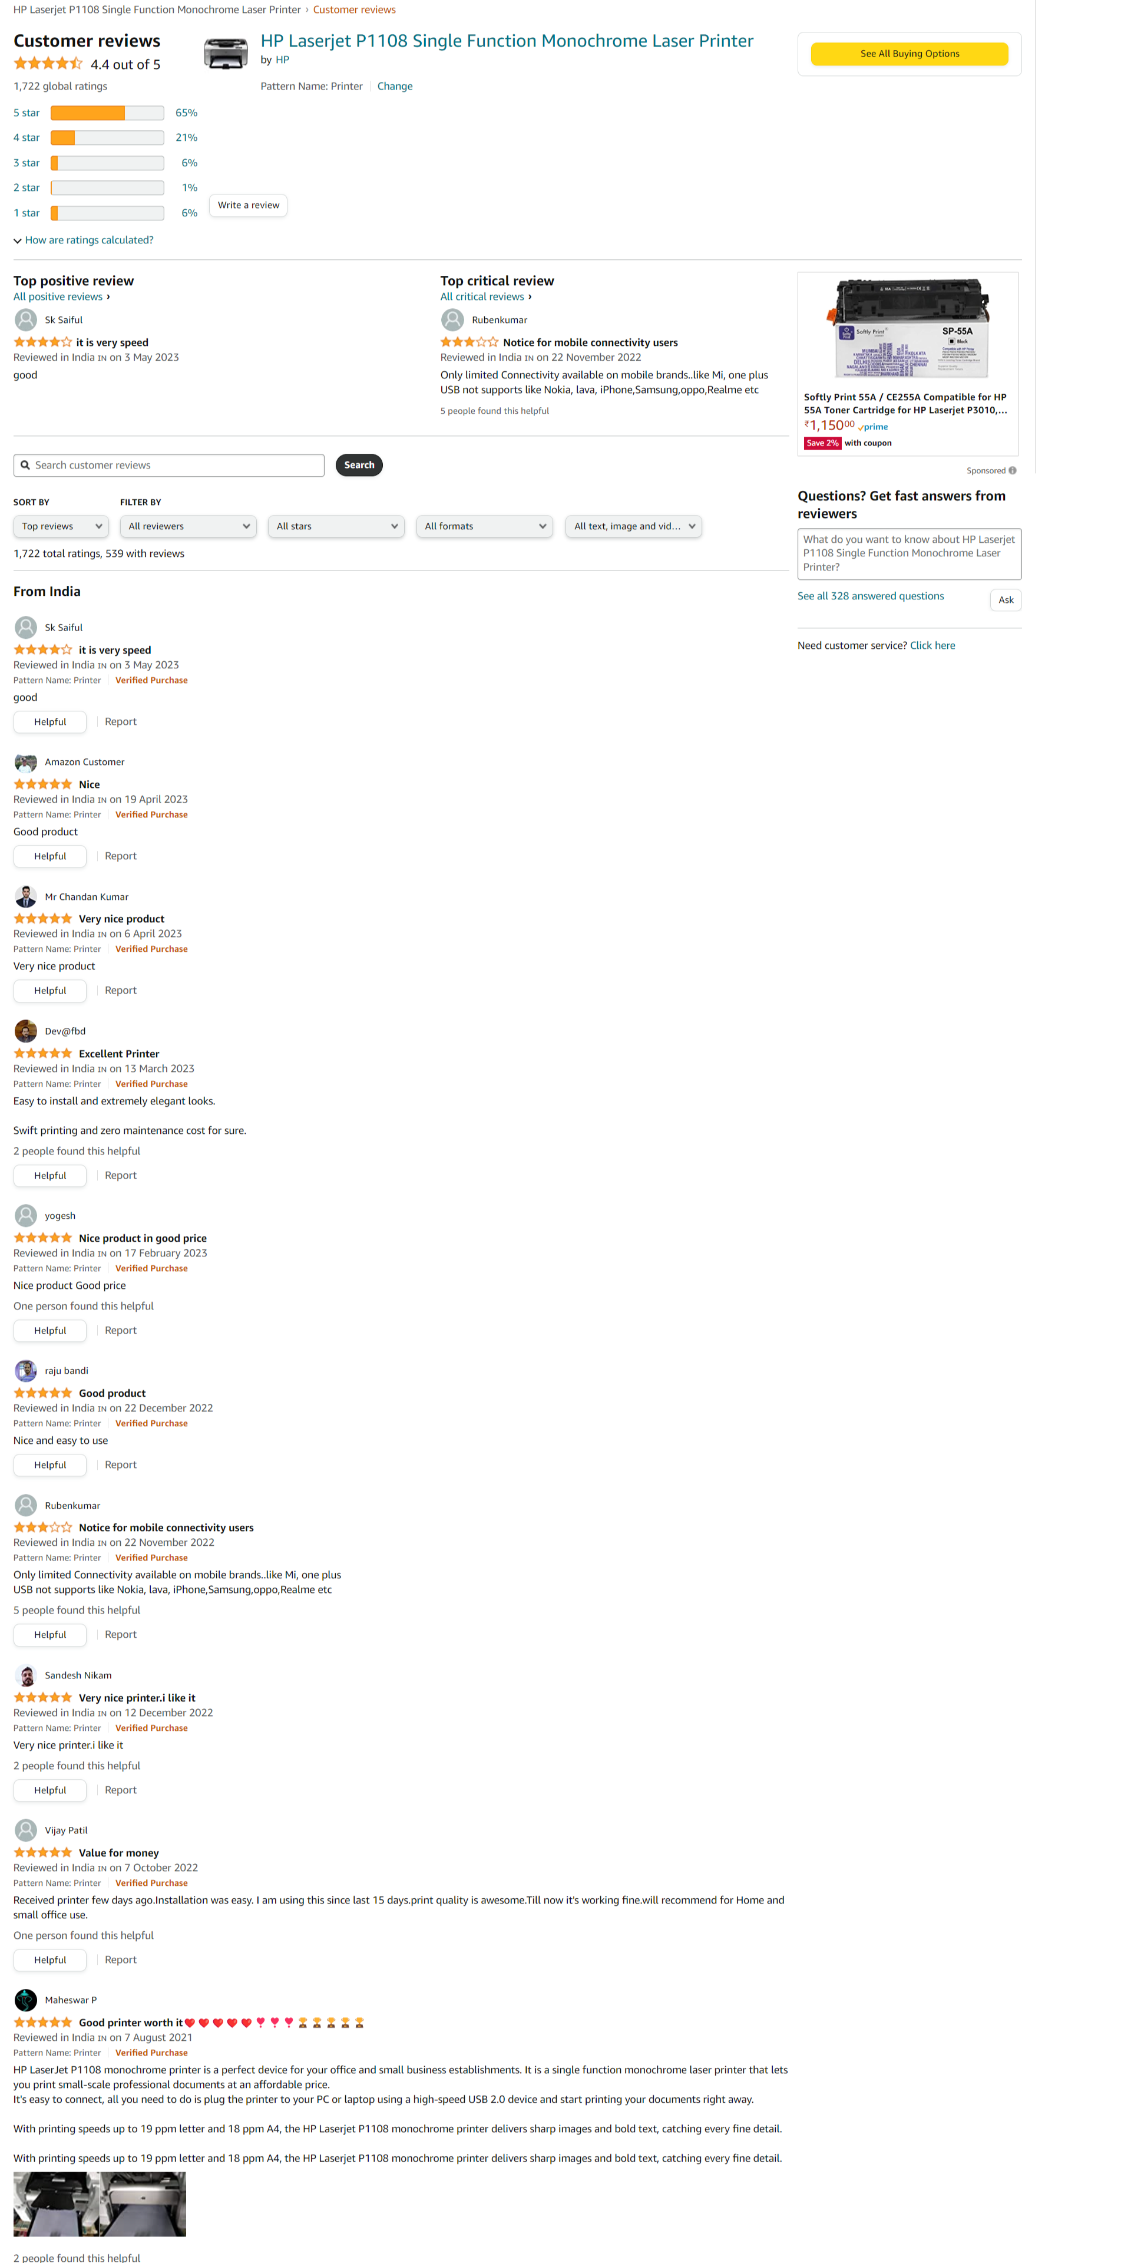
Social Media Posts as a Source of Data

Slide 9
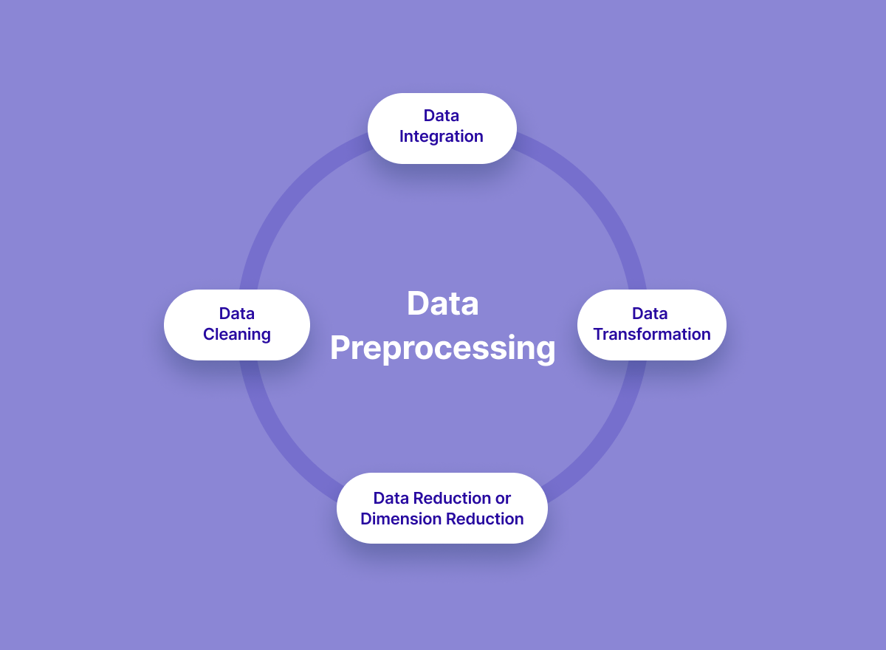
Data Extraction and Preprocessing

Slide 10
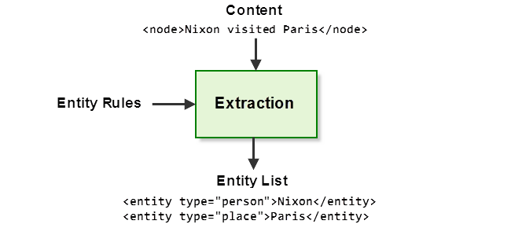
Entity Extraction and Attribute Identification

Slide 11
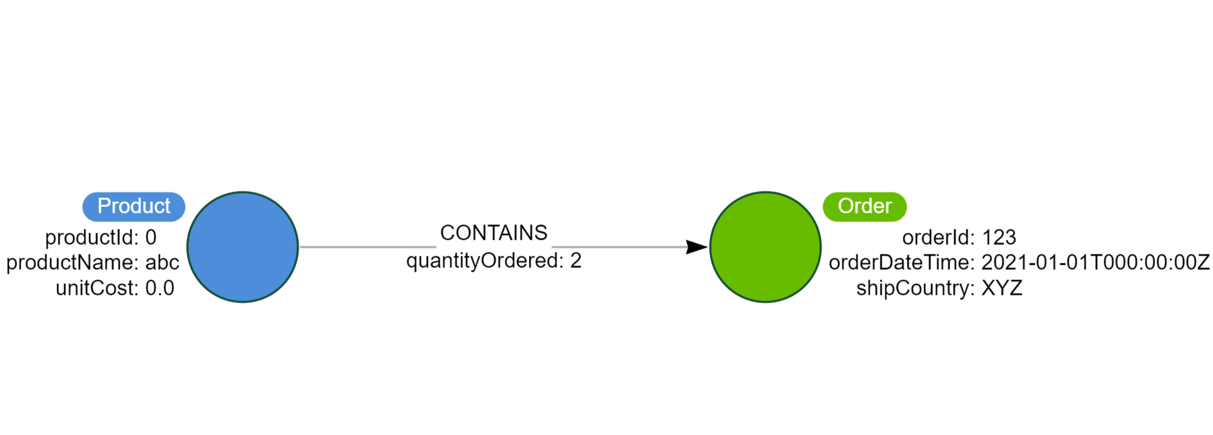
Relationship Identification

Slide 12
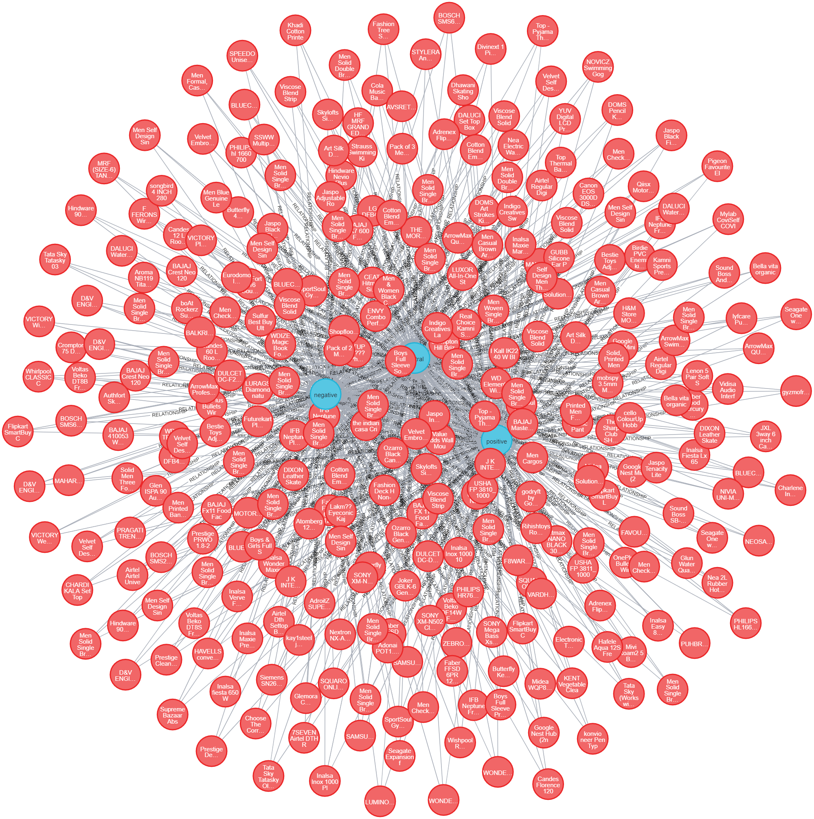
Knowledge Graph Construction

Slide 13
Benefits and Applications
Product Recommendations
Customer Support and Issue Resolution
Product Development and Innovation
Customer Insights
By building a knowledge graph, businesses can identify common trends, sentiments, and customer feedback
Leveraging the knowledge graph, businesses can recommend printers to social media users based on their expressed needs, preferences, and discussions
By integrating the knowledge graph with customer support systems, businesses can analyze social media posts to identify common printer issues and provide timely, accurate resolutions
Analyzing social media discussions on printers can provide businesses with a wealth of information regarding customer needs, feature requests, and pain points

Slide 14
Conclusion
Knowledge graphs are critical components for delivering customer value
Al techniques such as machine learning and predictive modelling from da-
ta are key parts of knowledge graph construction
This is particularly the case as the amount, speed and specificity of data
and requirements accelerates
Leveraging existing assets such as ontologies,data, and controlled have
been key assets for Elsevier in the build out of knowledge graphs
Another is it easy to identify data in it for the extraction process

Slide 15




References

Slide 16
Thank You

